Slide 1
Engineering Advisory Board Senior Project Review
Brandon Essary, Sunya Chay, William Flores

Slide 2
Roles and responsibilities
Responsibilities
All members are responsible to commutate with each other. The best teams will fail if there is poor or no commutation.
When presenting a roadblock team members should present options to get past the problem or be open to solicitation form other teammates.
Any team member should be ready to fill the role of another if that person is unavailable .
Roles
Brandon Essary (Team lead) Brandon is responsible for contact with the customer and setting up meetings. Created content pages, layout, and searchable table.
Sunya Chay (Team member) Research, coding, troubleshooting, hosting on MVC, web design, quality assurance, created CSS files.
William Flores (Team member) Research, ADA requirements, database design/coding, set-up static pages, calendar database.

Slide 3
Introductions
Team Introductions
Project name: kofc-wa.org website update
Project client: Dr. Olwell- Knights of Columbus Washington state council

Slide 4
Purpose of the project
The purpose of this project is to update the current Knights of Columbus Washington website to provide the client and end user a secure website that is sleek and easy to use. With this project we will provide a website that is easy to navigate for both the end user and the website administrator. The end state for this project is for the elected members to be able to communicate in mass with current and future members about past, current and future events in real time.

Slide 5
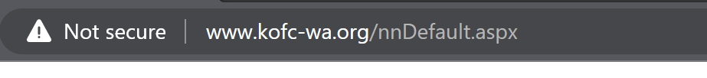
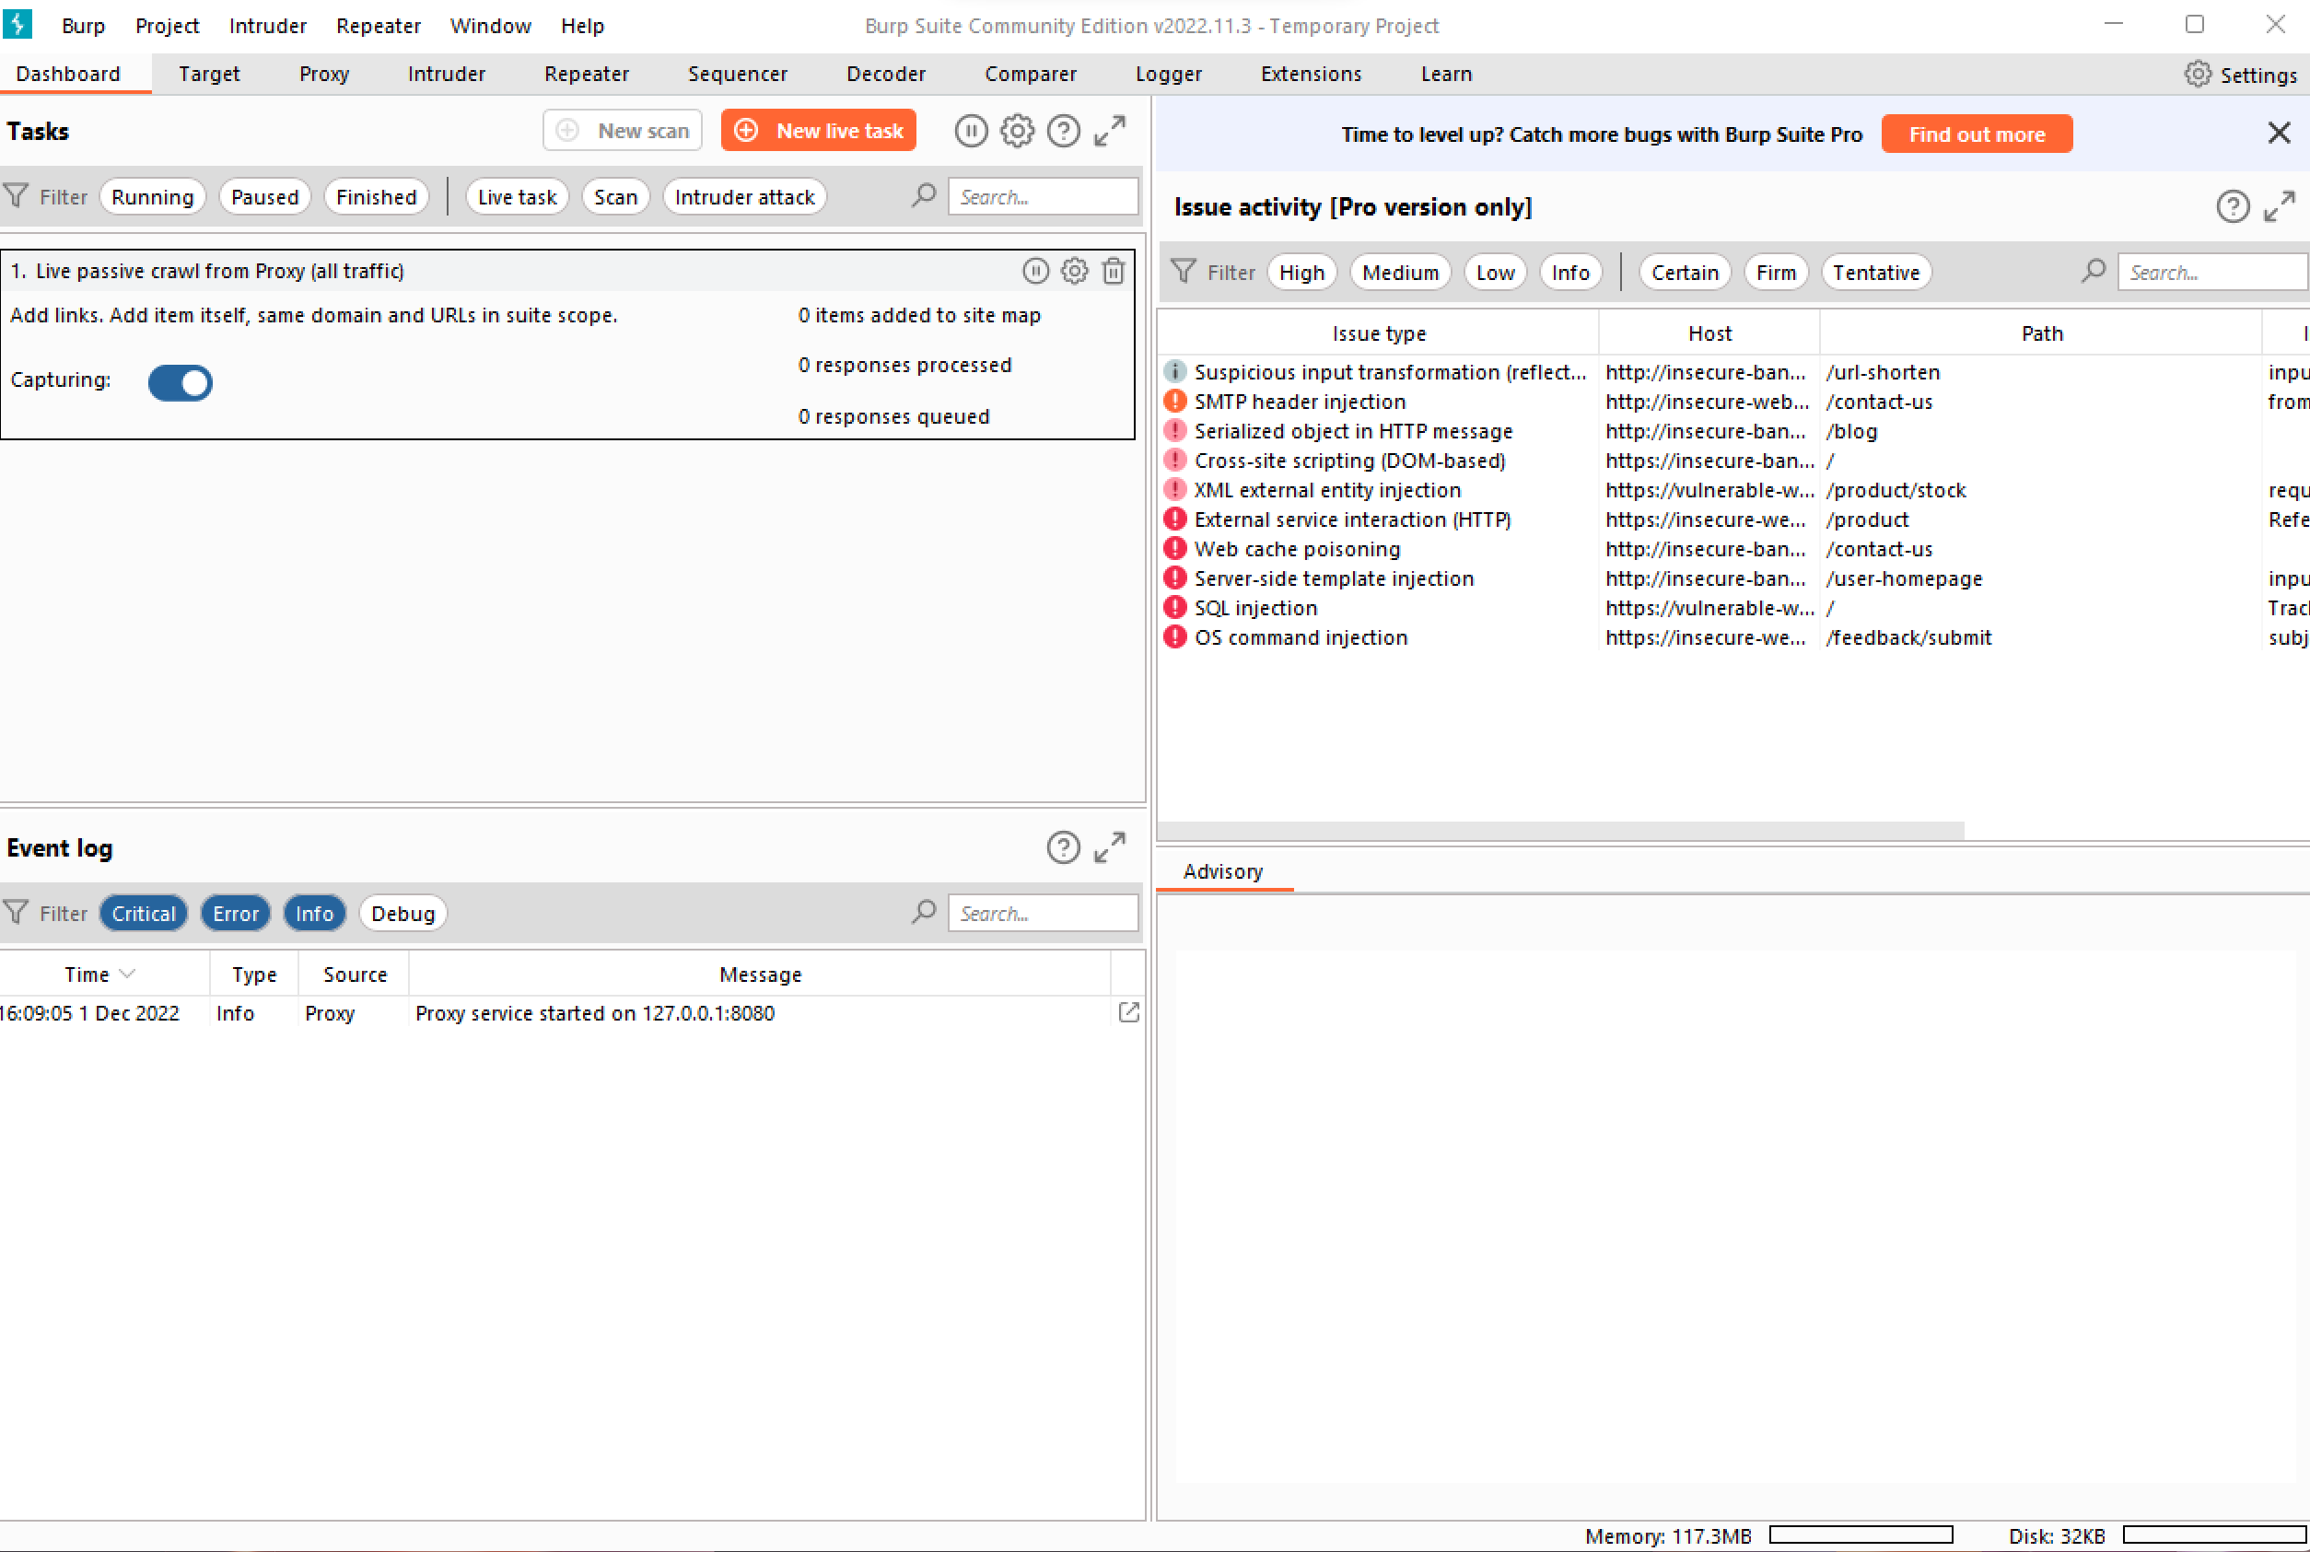
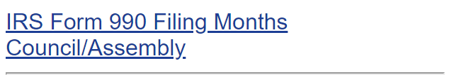
Current state of http://www.kofc-wa.org/
The current site is not secure.
Original code was created in 1995.
Current state of the database is not secure or encrypted.
The site is does have personal identifiable information leaks in more than one location.
The site is not used to pass information, not updated or used to full potential.
The current site is prime to hackers via SQL injection (Burp Suite) or other means.

Slide 6
Current Schedule
Date | Event | Notes
February 17th, 2023 | Poster 1 Due
February 20th, 2023 | Front end completed | Homepage with links to other pages
February 27th, 2023 | Login pages completed | Encrypt login pages to ensure security
March 13th, 2023 | Static Pages Complete | Get static pages encrypted
March 16th, 2023 | Security completed | Making sure that the website is secure. Following OWASP.org “Top 10 Security Risks”
March 20th, 2023 | Meeting with Members to approve the website | Ensuring that the client approves of the website and other feedback from the board
March 27th, 2023 | Finalize prototype and set up in host system | Placing prototype into server like AWS or Azure
March 30th , 2023 | Launch Prototype and Finish and Record Presentation | Make sure that Client likes the prototype and hand it over to them
April 6th, 2023 | Submit Presentation and All Links

Slide 7
Technical/qualitative project constraints
Access to data restricted to members only.
Ensuring that the website is secure, no pages are searchable.
ADA requirements for websites. Our goal for the new website is to be compliant to the checklist level AA at the time of development.
Having to learn webhost control panel to maximize website for the end user.
Meeting with the board: With meeting with the board, there was one vision for the new site and what we currently have as our prototype.

Slide 8
Risk
Cost: Website hosting is currently covered by overall budget. There is no risk with running over budget.
Schedule: Currently the team is on schedule, with a few exceptions as outlined in the schedule. The team has met with Knights of Columbus state board only once. With only meeting with the board, it was difficult to get the information that we needed for items like the database or how the website was hosted before we started the project.
Compliances: Using best practices for securing the website will come from coding the website and encrypting the database based on OWASP.org principles on securing a website. At the prototype phase the site will follow ADA requirements level AA.
Site performance: The current site is hosted on good webhost site however our goal is to move to webhost that will provide overall better performance and security. We have decided to go with AWSLightsail.
Additional requirements: As the project moves forward, add functions will slow production. Cutting functions based on level of priority for the website.

Slide 9
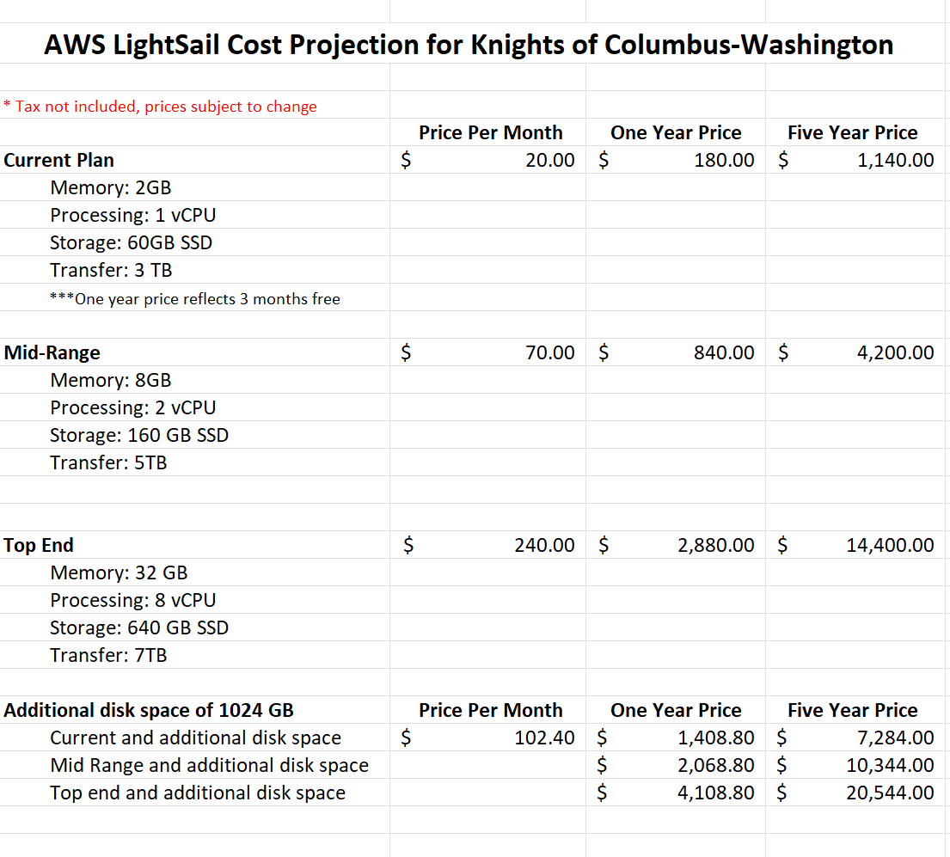
Current Budget
We are currently in budget.
Our biggest cost is the host website. The client wishes to use AWSLightsail.
Client is looking to see if they want to go with 1TB of storage or stick with the current plan of 2GB. Both of which are different price points.
Compared to the other hosting sites that we were looking at; AWS was the better deal than the others.

Slide 10
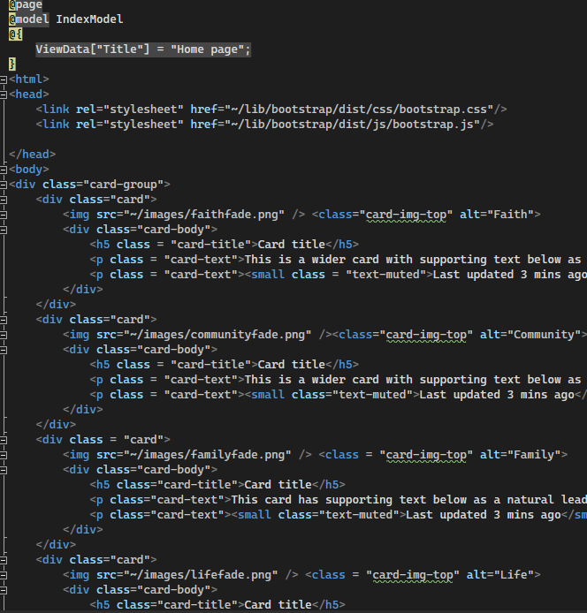
Implementation
Using both Visual Studio and Visual Studio Code to create the prototype of the website.
Having to work with bootstrap5 for the website.
Using ASP.Net MVC to code our website.
Using languages such as JavaScript, HTML, and CSS.

Slide 11
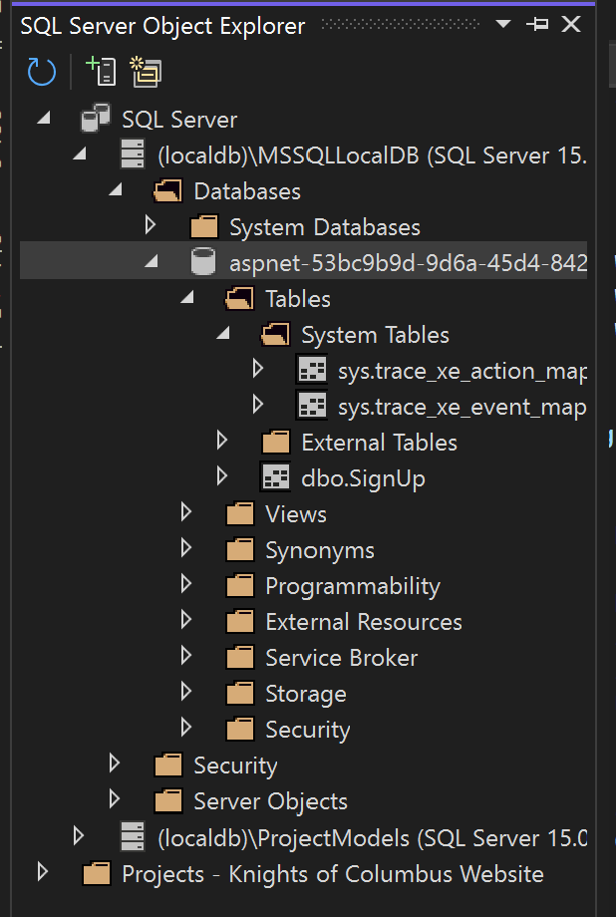
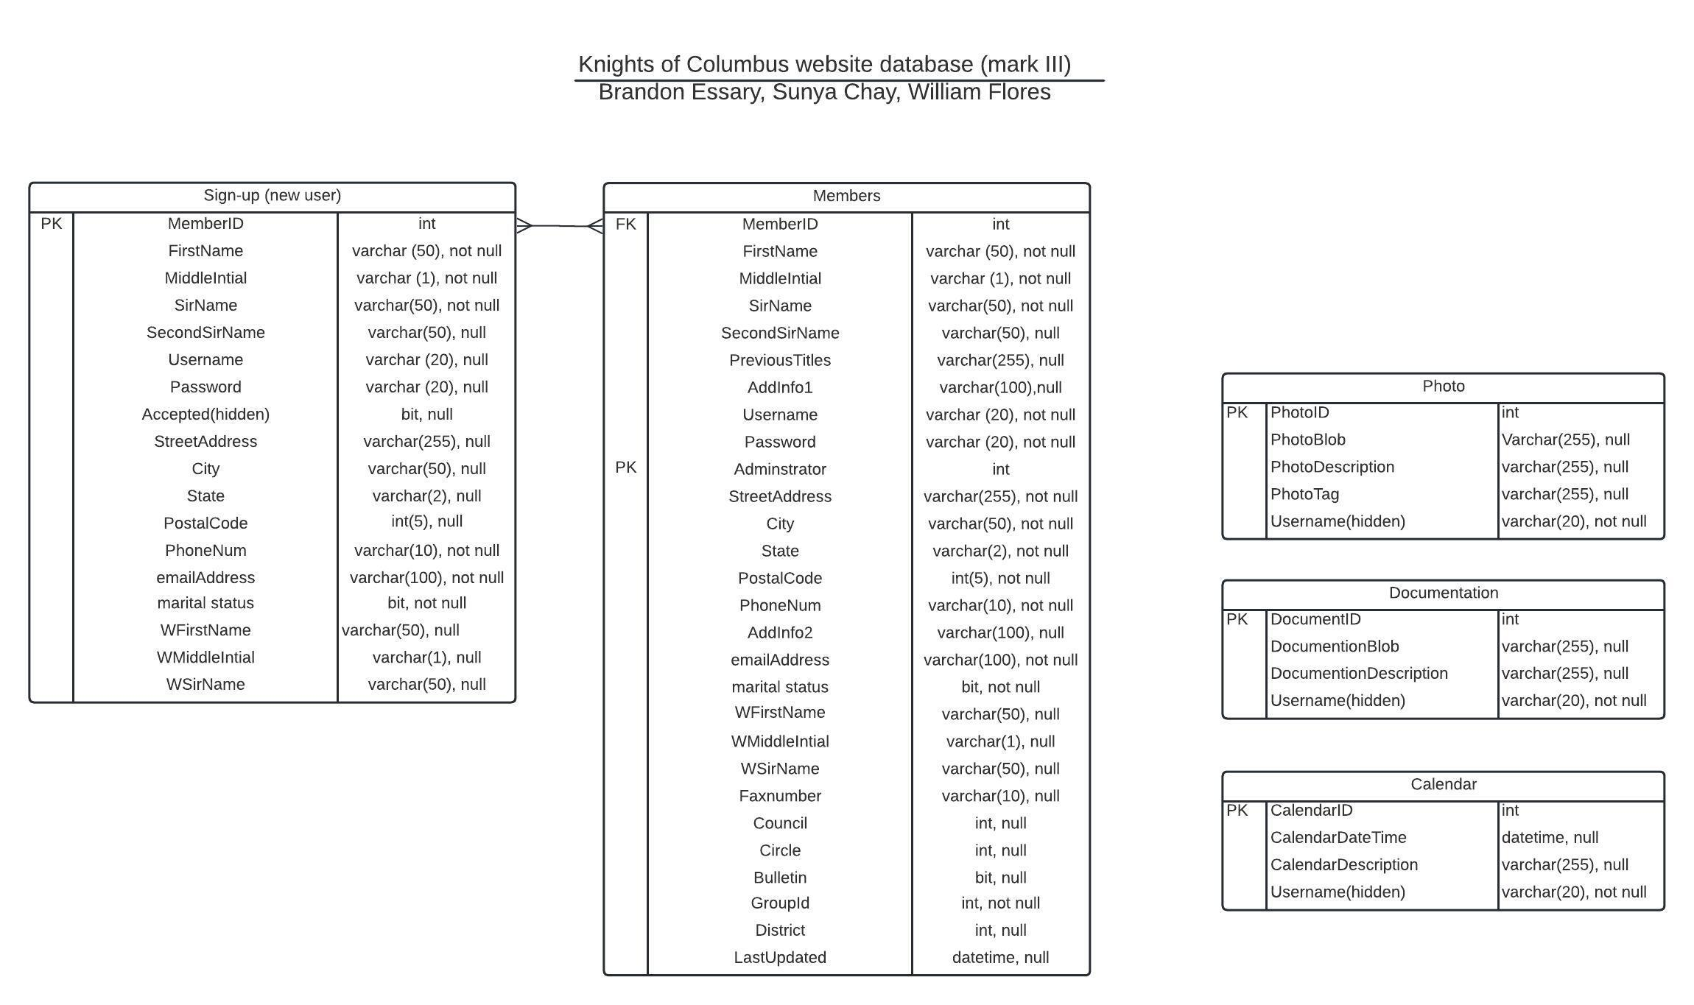
Database
We created our database using SQL Server.
Our database will be encrypted, as well as a simpler version compared to the older one.
Our current database manager is Marcus. However, once we hand it off to the client, it will be the Web Master to maintain the database.
Calendar database appears on the website, working on ensuring that the dates can be filterable and viewable
Old database is using IIS Database Manager. It’s also using denormalized tables and views.

Slide 12
Security
Ensuring the website has a secure connection. We are currently using a self certificate for the prototype.
Using OWASP.org “Top 10 Web Application Security Risks” to make sure that we are following all of the security protocols for the website.
Encrypting the database with row-level encryption. This will cover things like names, addresses, passwords, and usernames.
Our webhost, AWSLightsail has its own built-in security certificate.

Slide 13
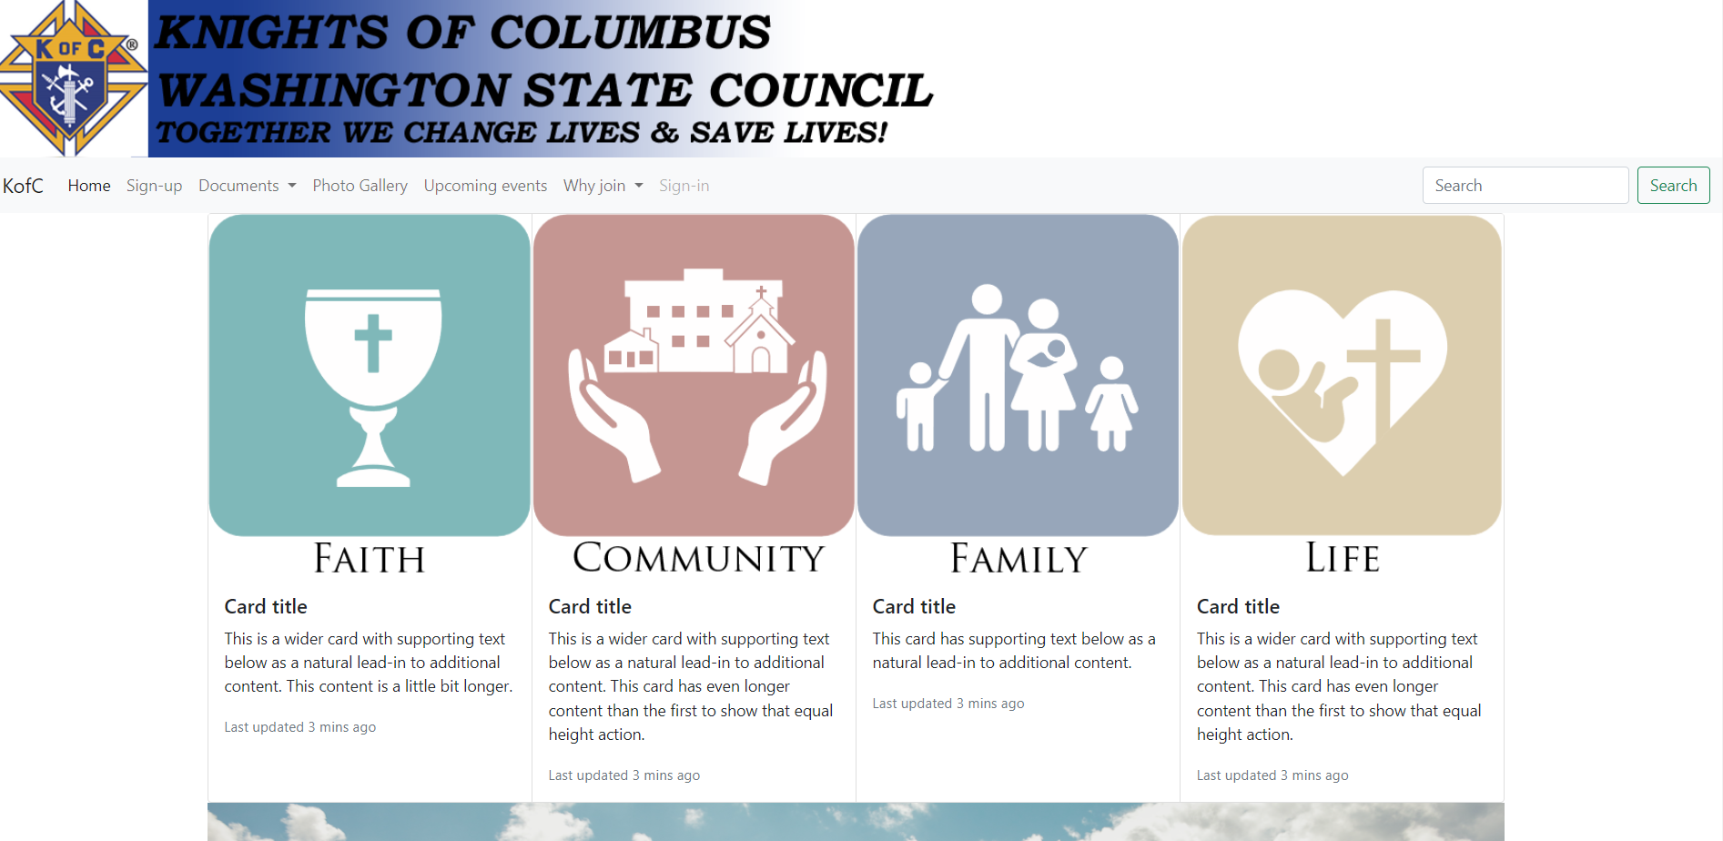
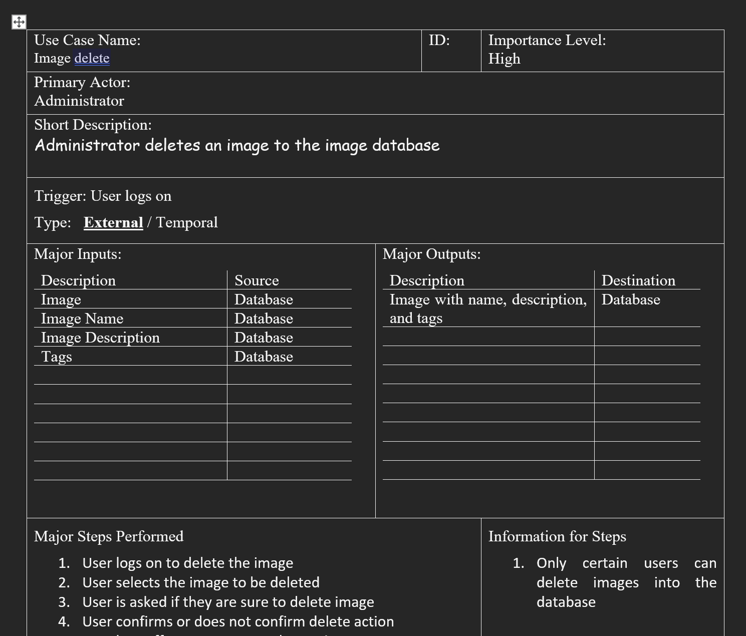
Progress
Use cases for document repository, calendar of events, and photo gallery (search, upload, and delete).
Homepage, and other pages are nearing completion.
Database being connected to the website.
Creating a working calendar database that is filterable

Slide 14
Next Steps
Project is nearing completion. The client will want to use the website when it is finished.
In the event that we do not finish the project, we will either hand it off to the next group or we will continue to work on it in the summer.
If our project isn’t complete, the client may also look at another solution to complete the website.
Copying the data from the old database into the new one.
Having a meeting with the original designer of the website.
Creating a user manual to give to the Web Master when we hand off the project.
Handing over the project to the Knights of Columbus. Making sure that there is proper documentation to ensure that someone else can maintain and work on what we have already done.

